Slide 1
Wheels, Axles and Pulleys

Slide 2
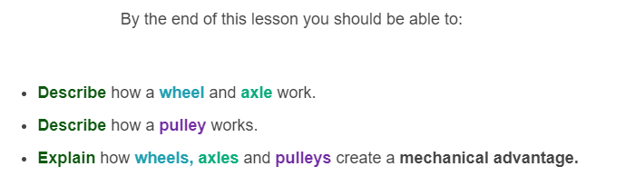
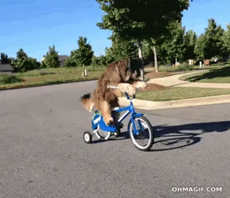

Slide 3
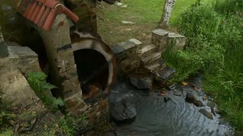
Wheels are often said to be the most important simple machine.
What would our lives be like without wheels? There would be no cars, bikes, fans, door handles or cool water wheels like this one:

Slide 4
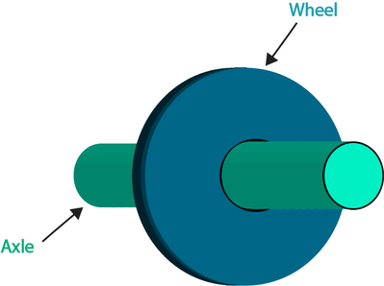
So how does a wheel work?
An axle is made from a solid rod and is attached to the middle of a wheel.

Slide 5
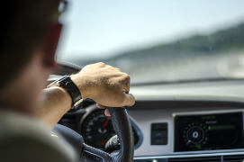
A wheel and axle allows us to save energy!
It is a lot easier to make the wheel spin than to make the axle spin. This is because it is a bigger sized circle.
For example, a steering wheel in a car is a wheel and axle. Would it be easier to turn it at the edge of the wheel, like the picture, or at the base where it connects to the car?

Slide 6
It always saves us energy to turn a wheel at the edge, rather than to turn the axle itself.
It is easier to turn the steering wheel at the edge, because this minimises the force needed to steer the car.

Slide 7
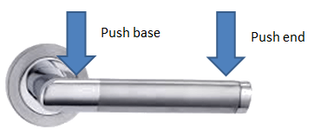
There are lots of examples in daily life where its easier to turn the wheel rather the base of the axle.
This is also true with a door handle. It is much easier to turn it at its end than at the base where it attaches to the door.
You can try this at home!

Slide 8
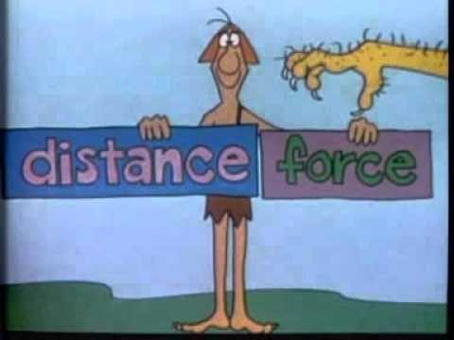

Slide 9
Pulleys are another simple machine that makes our daily lives much easier!
A pulley makes vertical lifting easier.
A pulley is a wheel with a groove around the edge.

Slide 10
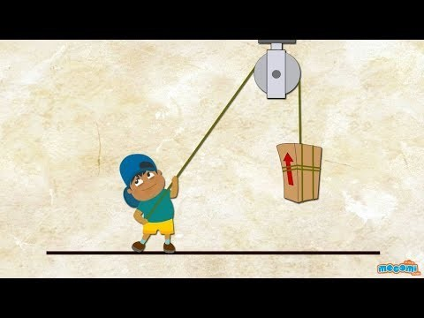

Slide 11
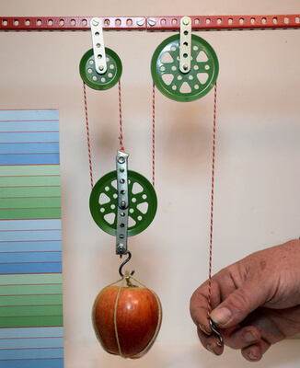
A pulley is made by putting two or more wheels together and looping a rope around them.
This creates a powerful lifting machine. Each time the rope wraps around a wheel, you create more lifting power or mechanical advantage, because this increases the distance!

Slide 12
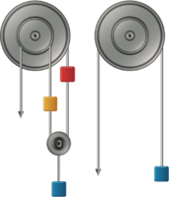
A load can be lifted more easily by a pulley when there are more wheels.
This increases the distance the load is distributed over and therefore increases the mechanical advantage.
Pulleys can be made with one, two, three or even four wheels!

Slide 13
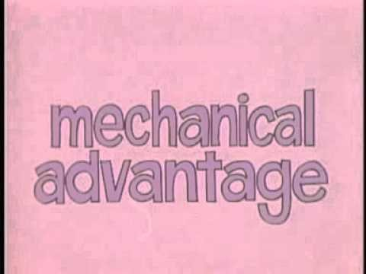

Slide 14
Pulleys are a bit like levers!
A seesaw is a type of lever. If you want to lift someone 4 times heavier than you on the seesaw, you need to sit 4 times further away from the fulcrum than they do.
When you sit further away from the fulcrum you apply effort over a larger distance. This means that a large force is produced.
The single banana on the left side of the lever below can balance the three bananas on the right side because it is hanging a greater distance from the fulcrum.

Slide 15
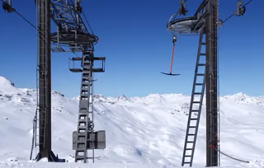
The same thing happens with a pulley except that you're pulling on a rope instead of moving the end of a seesaw!
To lift something four times heavier, you can use exactly the same force but only if you pull the rope four times further.
Both a pulley and a lever are providing a mechanical advantage by using the relationship between force and distance!

